Slide 1


Change – the only constant
Kent and Medway Pathology Network
Delphine Barraclough, Business Change Manager
Amanda Price, Workforce Project Director
7th April 2022
Did You Know (Officially updated for 2022) #2022 - YouTube
Transforming health and social care in Kent and Medway is a partnership of all the NHS organisations in Kent and Medway, Kent County Council and Medway Council.
We will work together to make health and wellbeing better than ant partner can do alone.

Slide 2

Change Strategy
The change strategy is a key enabler of any major programme of work and we have three aims for this presentation
Notes:
AMANDA
Youtube video link
Describe the different aspects of change
To start the conversation about what are the roles and responsibilities of pathology leads and SMEs as we move into the next phase of Kent & Medway pathology programme (we need to extend to the general pathology workforce as well as it is an open session)
To discuss individual and team strategies and actions for not just managing change but thriving through change

Slide 3
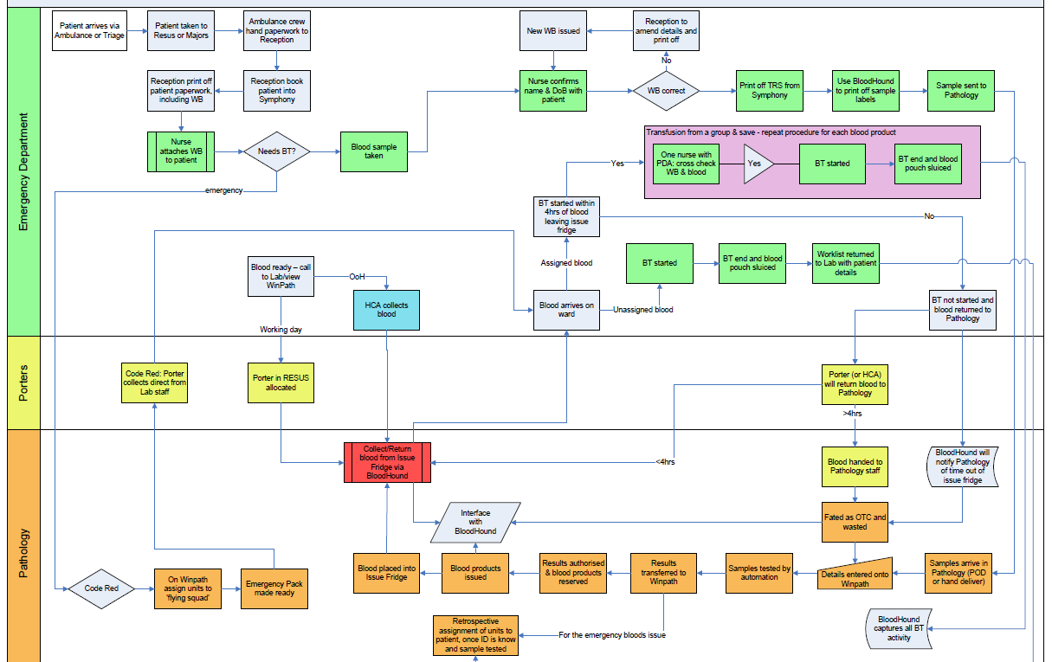
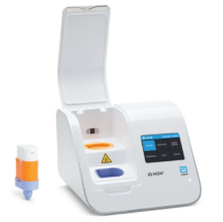
Change and Transformation
What is the difference?
  Why is transformation important?
Notes:
DELPHINE
A new instrument
A new workflow from manual to electronic – new roles for different staff groups, move from retrospective report to real-time auditing, reduction in wastage, reduction in patient harm

Slide 4
Change and Transformation in the Pathology Network
Change | Transformation
Upgraded analyser in a single lab | WinPath Enterprise v7.24 SP3 LIMS Implementation
Successful business case for an additional administrator | Network-wide Managed Equipment Services contract procurement
Faster printer in department | New GP & Community Order Comms System
Job share between two colleagues | Building a sustainable workforce
Notes:
DELPHINE

Slide 5
Aspects of Change
Change control
Enabling change
Behavioural change
Strategic change
Business change
Notes:
AMANDA

Slide 6
Strategic Change
Network Strategic objectives
Review against ICS strategy and ops plans
SWOT and PESTLE
Network transformation objectives
Network delivery plan
Notes:
AMANDA

Slide 7
The 7 Domains that characterise a Pathology Network are:
Governance | A single governance model signed off by all network member Trust and ICS Boards, with clear clinical and operational leadership arrangements where dissolution would require Trust Board approval
Leadership | A single accountable officer appointed at network level e.g. Network SRO, and other leadership roles defined and appointed to
Operational | Operational consolidation of services at agreed sites and integration into clinical pathways and business models signed off by Trust Boards
Quality | A common quality management process and methodology for oversight of performance, quality and clinical governance including working with local, regional and national systems such as PQAD and single UKAS accreditation process.
IT and digital | A digital roadmap setting out how the network will achieve digital interoperability across the whole local healthcare system and digitization of cellular pathology services with shared digital pathology reporting.
Workforce | Agreed workforce strategy for passporting/mobility, Skill mix (including the role of clinical scientists), training and CPD and recruitment and retention, managed via a Network workforce lead
Shared supply chain | A shared joint procurement strategy with robust supply chain and joint purchasing at scale for example shared Managed Service Contract across the network, or a clear process and timeline to achieve one.

Slide 8
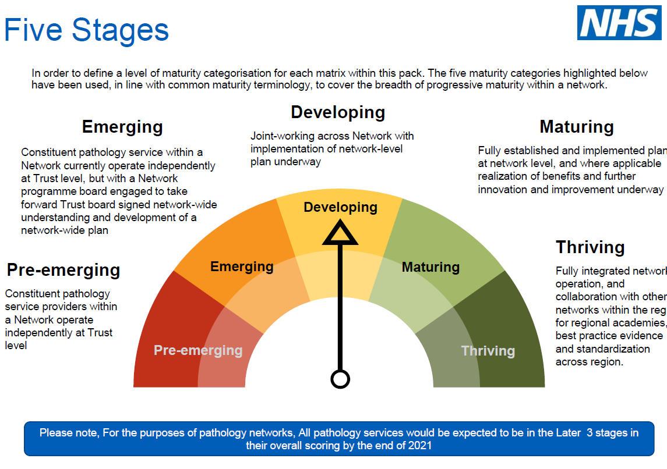
Notes:
AMANDA
Working on this for the next three years

Slide 9


Business Change
Notes:
DELPHINE

Slide 10
Change Control
Change management process – aligned to the QMS, which needs to align to the contractual obligations
  Details the action to be taken if a change to the original plan is required
    Will be part of the contract management arrangements for LIMS and MES
Notes:
DELPHINE
Quality Management System –this will become a network system due to the LIMS and MES implementations requiring three sets of SOPs and WIs into one.

Slide 11
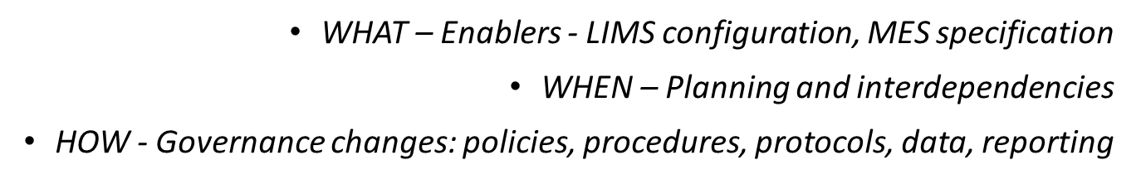
Enabling change
What needs to change in order to deliver the business change?
  WHO - Workforce changes – role, number, skill mix, task, shift pattern, team structure, training needs
  WHERE – Discipline/space changes – where a ‘to be’ process is undertaken
Notes:
DELPHINE

Slide 12
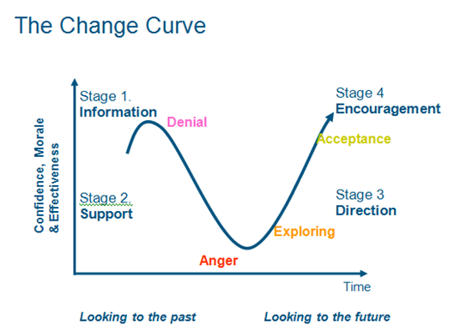
Behavioural change
80% of change is about people
Kubler Ross
Notes:
AMANDA
Individual response to change

Slide 13
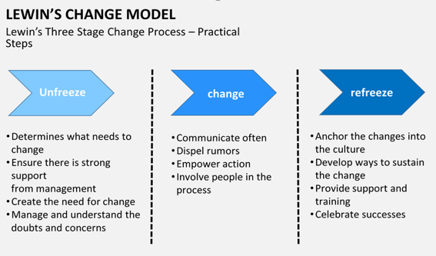
Lewin’s Change Model

Slide 14
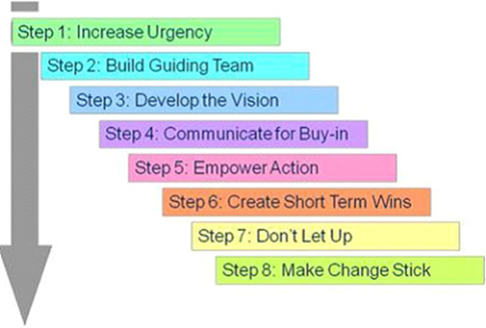
Kotter’s 8 stage model

Slide 15
Contributing to aspects of change
 | Strategic change | Business change | Change Control | Enabling change | Behavioural change
Example | > Highlight local, regional and national developments impacting on network strategic objectives | > Review the outputs of process mapping and harmonisation to ensure alignment with service/organisational requirements | > Receive reports on changes to agreed baselines and approve where required. | > Develop new SOPs for agreed processes | > Identify and highlight barriers to change and solutions
Notes:
DELPHINE

Slide 16
How can I as an individual and/or my team contribute?
 | Strategic change | Business change | Change Control | Enabling change | Behavioural change
YOUR IDEAS
Notes:
BOTH

